Slide 1
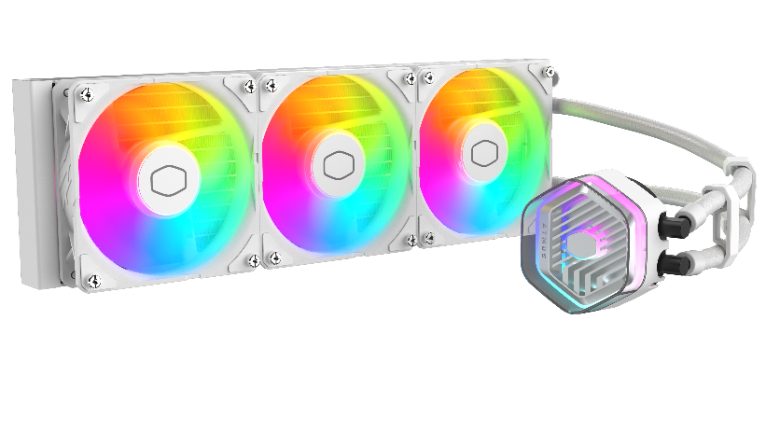
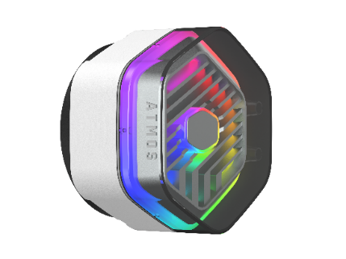
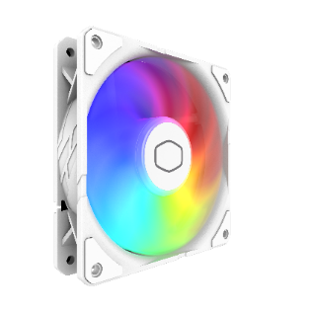
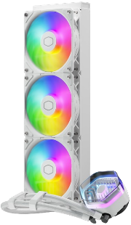
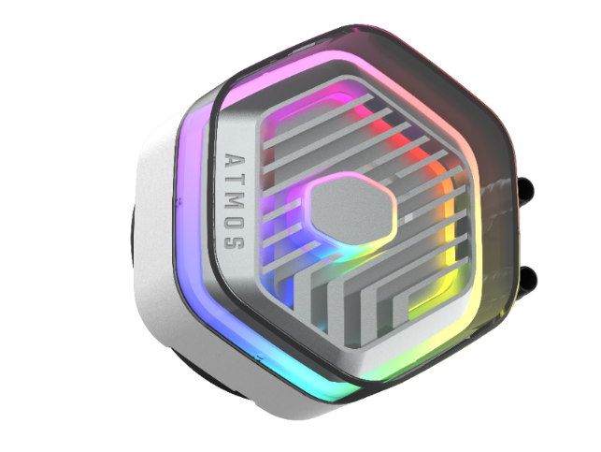
Cooler Master is unveiling the next generation of liquid cooling engineering with the MasterLiquid 360 Atmos White, our new AIO liquid cooler, now available in an ice-cool white colorway. With the Atmos series, we are introducing a multitude of modern designs and features. Our signature dual chamber pump has been refined for enhanced cooling synergy. The latest SickleFlow Edge ARGB fans are included to silently improve air flow and are preinstalled to simplify installation and the overall user experience. The pump cover is manufactured from eco-friendly recycled plastics and features a transparent, removable top cover that you can customize with your own logo or badge. The Atmos supports Addressable Gen 2 RGB for the most versatile and vibrant lighting, compatible with both our MasterPlus and MasterControl software. Cooler Master is leaping into the future with the Atmos series.
MASTERLIQUID
360 ATMOS WHITE
Refined dual chamber design
Latest Sickleflow Edge 120 fans
ARGB Gen 2 lighting
Our signature dual chamber pump has been refined for enhanced cooling synergy
Pre-installed SickleFlow Edge 120mm fans further improve cooling performance and simplify user installation
Next generation lighting with addressable Gen 2 RGB, compatible with both MasterPlus and MasterControl
All-white colorway
This all-white colorway will keep your machine looking ice-cool.
Customizable pump top cover
Removable pump top cover, customizable with your own 3D-printed designs
Eco-friendly pump cover
The entire pump cover is manufactured with eco-friendly recycled plastics, putting our environment first

Slide 2
Refined dual chamber design - Our signature dual chamber pump has been refined for enhanced cooling synergy
Latest Sickleflow Edge 120 fans - Pre-installed SickleFlow Edge 120mm fans further improve cooling performance and simplify user installation
ARGB Gen 2 lighting - Next generation lighting with addressable Gen 2 RGB, compatible with both MasterPlus and MasterControl
Customizable pump top cover - Removable pump top cover, customizable with your own 3D-printed designs
Eco-friendly pump cover - The entire pump cover is manufactured with eco-friendly recycled plastics, putting our environment first
All-white colorway- This all-white colorway will keep your machine looking ice-cool
Product Name |  | MasterLiquid 360 Atmos White
Product Number |  | MLX-D36M-A25PZ-RW
Exterior Color |  | White
CPU Socket | Intel | Intel® LGA 1700 / 1200 / 1151 / 1150 / 1155 / 1156 / socket
 | AMD | AMD® AM5 / AM4 socket
Radiator | Material | Aluminum
 | Dimensions (L x W x H) | 394 x 119.6 x 27.2mm(15.5 x 4.7 x 1.1 inch)
Pump | Dimensions (L x W x H) | 84.9 x 81 x 53.15 mm(3.3 x 3.2 x 2.1 inch)
 | MTTF | > 210,000 hours
 | Noise Level (Max) | 12 dB(A)
 | Connector | 4-Pin
 | Rated Voltage | 12 VDC
 | Power Consumption | 3.84 W
Fan | Dimensions (L x W x H) | 120 x 120 x 25 mm(4.7 x 4.7 x 1 inch)
 | Quantity | 3 Pcs
 | LED Type | ARGB
 | Speed (RPM) | 690 ~2500 ± 10%
 | Airflow (Max) | 120m³/h (70.7 CFM)
 | Noise Level (Max) | 27.2 dB(A)
 | Pressure (Max) | 3.61 (mmH2O)
 | Bearing | Loop dynamic bearing
 | MTTF | >160,000 hours
 | Power Connector | 4-Pin PWM
 | Rated Voltage | 12 VDC
 | Rated Current | 0.2 A
 | Safety Current | 0.3 A
RAM Clearance |  | N/A
Warranty |  | 5 years
EAN code | 4719512139974
UPC code | 884102112294
Net weight | 1.79 kg
Gross weight | 3.28 kg
Package dimension (L x W X H) | 41 X 21.1 X 13.6 cm
Carton dimension (L x W x H) | 43 X 43 X 30 cm
Units/CTN | 4
Cont. | W/ Pallet | Carton/ Pallet | W/O Pallet
20’ | 960 | 24 | N/A
40’ | 1920 | 24 | N/A
40 HQ | 2240 | 28 | N/A

